Slide 1
Chapter 2
Probability
Chapter 2
Probability

Slide 2
Some Terminologies
Chapter 2.1
Sample Space
Data: result of observation that consists of information, in the form of counts, measurements, or responses.
Parameter: numerical description of a population characteristics.
Statistic: numerical description of a sample characteristics.
Population: the collection of all outcomes, counts, measurements, or responses that are of interest.
Sample: a subset of a population.

Slide 3
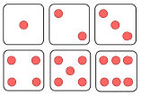
Sample Space
Chapter 2.1
Sample Space
Experiment: any process that generates a set of data.
Sample space: the set of all possible outcomes of a statistical experiment. It is represented by the symbol S.
Element or member: each outcome in a sample space. Sometimes simply called a sample point.
The sample space S, of possible outcomes when a coin is tossed may be written as
where H and T correspond to “heads” and “tails”, respectively.
The sample space can be written according to the point of interest. Consider the experiment of tossing a die. The sample space can be

Slide 4
Sample Space
Chapter 2.1
Sample Space
Suppose that three items are selected at random from a manufacturing process. Each item is inspected and classified defective, D, or nondefective, N. As we proceed along each possible outcome, we see that the sample space is
Sample spaces with a large or infinite number of sample points are best described by a statement or rule.
For example, if the possible outcomes of an experiment are the set of cities in the world with a population over million, the sample space is written
If S is the set of all points (x, y) on the boundary or the interior of a circle of radius 2 with center at the origin, we write

Slide 5
Events
Chapter 2.2
Events
A set is a collection of unique objects.
A set A is a subset of another set B if every element of A is also an element of B. We denote this as A ⊆ B.
Event: a subset of a sample space. We are interested in probabilities of events.
The event A that the outcome when a die is tossed is divisible by 3 is the subset of the sample space S₁, and can be expressed as
The event B that the number of defectives is greater than 1 in the example on the previous slide can be written as
Given the sample space S = {t | t ≥ 0}, where t is the life in years of a certain electronic components, then the event A that the component fails before the end of the fifth year is the subset A ={t|0 ≤ t < 5}.

Slide 6
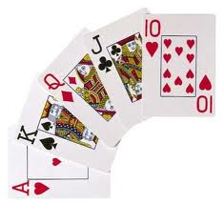
Chapter 2.2
Events
Events
Null set: a subset that contains no elements at all. It is denoted by the symbol ∅.
The complement of an event A with respect to S is the subset of all elements of S that are not in A. We denote the complement of A by the symbol A’.
Let R be the event that a red card is selected from an ordinary deck of 52 playing cards, and let S be the entire deck. Then R’ is the event that the card selected from the deck is not a red but a black card.
S
A
A’

Slide 7
Chapter 2.2
Events
Events
The intersection of two events A and B, denoted by A ∩ B, is the event containing all elements that are common to A and B.
S
A
B
A ∩ B
Two events A and B are mutually exclusive, or disjoint if A ∩ B = ∅, that is, if A and B have no elements in common.
S
A
B
A ∩ B = ∅

Slide 8
Chapter 2.2
Events
Events
The union of two events A and B, denoted by A ∪ B, is the event containing all elements that belong to A or B or both.
S
A
B
A ∪ B
Let A = {a, b, c} and B = {b, c, d, e}; then
A ∩ B = {b, c}
A ∪ B = {a, b, c, d, e}
If M = {x |3 < x < 9} and N = {y | 5 < y < 12}; then
M ∪ N = {z | 3 < z <12}
M ∩ N = ?

Slide 9
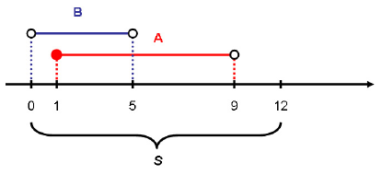
Chapter 2.2
Events
Events
If S = {x | 0 < x < 12}, A = {x | 1 ≤ x < 9}, and B = {x | 0 < x < 5}, determine
A ∪ B
A ∩ B
A’ ∪ B’
A ∪ B =
A ∩ B =
A’ ∪ B’ =
{x | 0 < x < 9}
{x | 1 ≤ x < 5}
(A ∩ B)’
= {x | 0 < x < 1, 5 ≤ x <12}

Slide 10
Chapter 2.2
Events
Venn Diagram
Like already seen previously, the relationship between events and the corresponding sample space can be illustrated graphically by means of Venn diagrams.
S
A
B
2
7
6
1
4
3
5
C
8
{1, 2}
{1, 3}
{1, 2, 3, 4, 5, 7}
{4, 7}
{1}
{2, 6, 7}
A ∩ B =
B ∩ C =
A ∪ C =
B’ ∩ A =
A ∩ B ∩ C =
(A ∪ B) ∩ C’ =

Slide 11
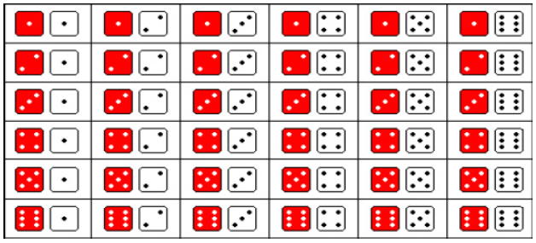
Chapter 2.3
Counting Sample Points
Counting Sample Points
Goal: to count the number of points in the sample space without actually enumerating each element.
|Multiplication Rule| If an operation can be performed in n₁ ways, and if for each of these a second operation can be performed in n₂ ways, then the two operations can be performed together in n₁·n₂ ways.
How may sample points are in the sample space when a pair of dice is thrown once?

Slide 12
Chapter 2.3
Counting Sample Points
Counting Sample Points
Sam is going to assemble a computer by himself. He has the choice of ordering chips from two brands, a hard drive from four, memory from three and an accessory bundle from five local stores. How many different ways can Sam order the parts?
Since n₁ = 2, n₂ = 4, n₃ = 3, and n₄ = 5,
there are n₁·n₂·n₃·n₄ = 2·4·3·5 = 120 different ways to order the parts

Slide 13
Chapter 2.3
Counting Sample Points
Counting Sample Points
How many even four-digit numbers can be formed from the digits 0, 1, 2, 5, 6, and 9 if each number can be used only once?
For even numbers, there are n₁ = 3 choices for units position. However, the thousands position cannot be 0.
If units position is 0, n₁ = 1, then we have n₂ = 5 choices for thousands position, n₃ = 4 for hundreds position, and n₄ = 3 for tens position. In this case, totally n₁·n₂·n₃·n₄ = 1·5·4·3 = 60 numbers.
If units position is not 0, n₁ = 2, then we have n₂ = 4, n₃ = 4, and n₄ = 3. In this case, totally n₁·n₂·n₃·n₄ = 2·4·4·3 = 96 numbers.
The total number of even four-digit numbers can be calculated by
60 + 96 = 156.
?
How if each number can be used more than once?

Slide 14
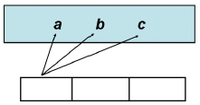
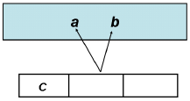
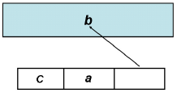
Chapter 2.3
Counting Sample Points
Permutation
A permutation is an arrangement of all or part of a set of objects.
Consider the three letters a, b, and c. There are 6 distinct arrangements of them: abc, acb, bac, bca, cab, and cba.
There are n₁ = 3 choices for the first position, then n₂ = 2 for the second, and n₃ = 1 choice for the last position, giving a total n₁·n₂·n₃ = 3·2·1 = 6 permutations.

Slide 15
Chapter 2.3
Counting Sample Points
Permutation
In general, n distinct objects can be arranged in n(n–1)(n–2) · · · (3)(2)(1) ways.
This product is represented by the symbol n!, which is read “n factorial.”
The number of permutations of n distinct objects is n!
The number of permutations of n distinct objects taken r at a time is

Slide 16
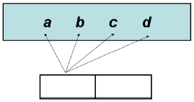
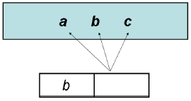
Chapter 2.3
Counting Sample Points
Permutation
Consider the four letters a, b, c, and d. Now consider the number of permutations that are possible by taking 2 letters out of 4 at a time.
The possible permutations are ab, ac, ad, ba, bc, bd, ca, cb, cd, da, db, and dc.
d
There are n₁ = 4 choices for the first position, and n₂ = 3 for the second, giving a total n₁·n₂ = 4·3 = 12 permutations.
Another way, by using formula,

Slide 17
Chapter 2.3
Counting Sample Points
Permutation
Three awards (research, teaching and service) will be given one year for a class of 25 graduate students in a statistics department. If each student can receive at most one award, how many possible selections are there?

Slide 18
Chapter 2.3
Counting Sample Points
Permutation
A president and a treasurer are to be chosen from a student club consisting of 50 people. How many different choices of officers are possible if
There are no restrictions
A will serve only if he is president
B and C will serve together or not at all
D and E will not serve together
₅₀P₂
₄₉P₁ + ₄₉P₂
₂P₂ + ₄₈P₂
₅₀P₂ – 2 or {2·₂P₁·₄₈P₁ + ₄₈P₂}
?
For detailed explanation read the e-book.

Slide 19
Chapter 2.3
Counting Sample Points
Permutation
The number of distinct permutations of n things of which n₁ are of one kind, n₂ of a second kind, …, n_{k} of a k^{th} kind is
How many distinct permutations can be made from the letters a, a, b, b, c, and c?

Slide 20
Chapter 2.3
Counting Sample Points
Permutation
In a college football training session, the defensive coordinator needs to have 10 players standing in a row. Among these 10 players, there are 1 freshman, 2 sophomore, 4 juniors, and 3 seniors, respectively. How many different ways can they be arranged in a row if only their class level will be distinguished?

Slide 21
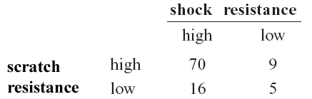
Probability and Statistics
Homework 1A
Disk of polycarbonate plastic from a supplier are analyzed for scratch and shock resistance. The result from 100 disks are summarized as follows.
Let A denote the event that a disk has high shock resistance, and let B denote the event that a disk has high scratch resistance.
Determine the number of disks in A ∩ B, A’, and A ∪ B. (Mo.2.26)
Construct a Venn Diagram that represents the analysis result above. Can you indicate all the events mentioned in (a)?
Two balls are “randomly drawn” from a bowl containing 6 white and 5 black balls. What is the probability that one of the drawn balls is white and the other black? (Ro.E3.5a)

Slide 22

Probability and Statistics
Homework 1B
You are given two boxes with balls numbered 1 to 5. One box contains balls 1, 3, and 5. The other box contains balls 2 and 4. You first pick a box at random, then pick a ball from that box at random. What is the probability that you pick the ball number 2? (Utah.L2)

Slide 23
Chapter 2.3
Counting Sample Points
Combination
In many problems we are interested in the number of ways of selecting r objects from n without regard to order. These selections are called combinations.
The number of combinations of n distinct objects taken r at a time is
A young boy asks his mother to get five game-boy cartridges from his collection of 10 arcade and 5 sport games. How many ways are there that his mother will get 3 arcade and 2 sports games, respectively?
The number of ways of selecting 3 arcade games is ₁₀C₃.
The number of ways of selecting 2 sports games is ₅C₂.
Using the multiplication rule,

